Slide 1
Some Basic Definitions

Slide 2
Deep Learning: Summary
Deep learning (DL) is a brain-inspired branch of machine learning (ML) based on networks comprised of layers of “artificial neurons.”
It gained popularity in 2012, when AlexNet won the ILSVC image classification challenge by a wide margin over traditional computer vision (CV) algorithms.
Today, DL powers many (most) breakthrough AI systems and applications, outperforming humans on a growing range of tasks from image classification to automatic speech recognition.
Leading DL models require hundreds of thousands/millions of artificial neurons and often take days and months to train on the latest hardware.
NVIDIA graphics processing units (GPUs) are the leading DL HW accelerators, Google is developing their own TPU technology for Google Cloud, and Intel and others are playing catch-up.
DL technologies are complex and exist at the unique intersection of machine learning, big data, cloud, and high-performance computing.

Slide 3

Not So Neural
DL is based on the concept of software-defined ”artificial neurons”
The artificial neuron receives a bunch of inputs and is either activated or isn’t
Static
The brain:
Dendrites ~= inputs
Axon ~= outputs
Synapses: connections
Action potential ~= signal
The firing rate is what varies
~100 billion neurons
1,000–10,000 synapses per neuron

Slide 4
What’s So Deep About It?

Slide 5
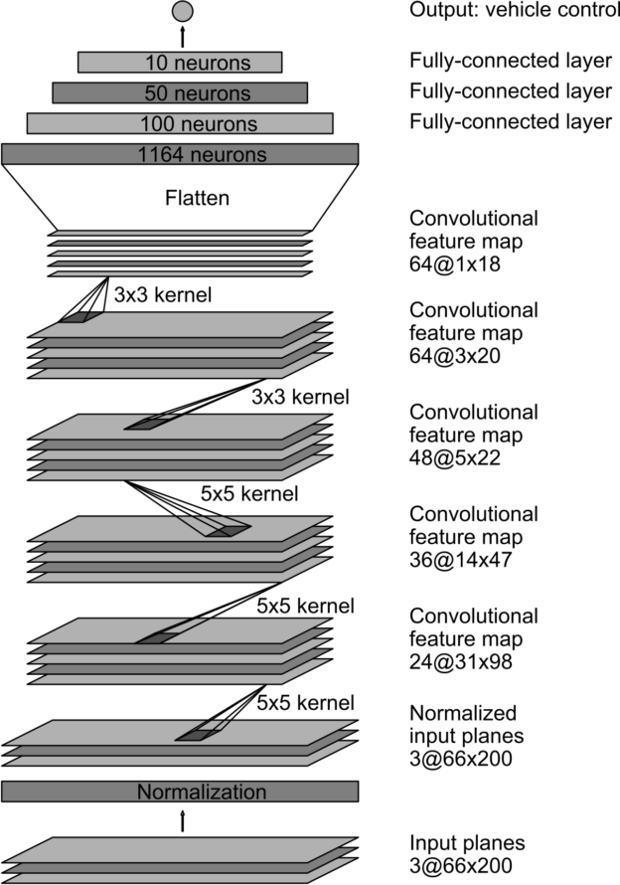
What’s So “Deep”?
Artificial layers in neural networks are arranged in layers.
If the neural network needs to be more adaptable, it needs to have more neurons.
Ultimately, this means more layers.
By convention, information flows from bottom up through a neural network.
Depth refers to the number of layers.
“Deep” neural networks are the more complex ones.

Slide 6

The Datasets
Neural networks tend to be very complex and as a result, have a lot of parameters
Consequently, they overfit very easily
Need massive data sets
Need to be hand tagged
Tools need to be built
22,000 categories
>14 million labeled images
>1 million with bounding boxes
Tagged via AWS Mechanical Turk
>300,000 images with labeled and segmented objects

Slide 7
The Technique
Activations need to be nonlinear in order not to collapse across layers
Sigmoids are relatively computationally intensive
Also saturate away from zero
Rectified linear unit (ReLu) is one solution
Sigmoid
ReLu

Slide 8
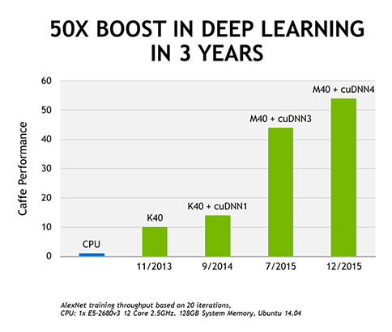
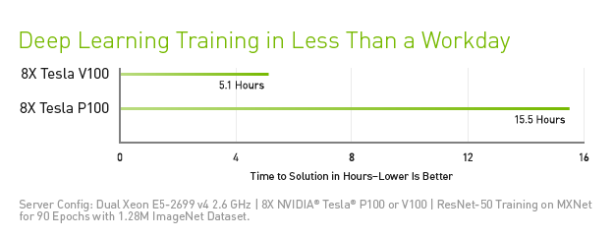
The Processing Power
Once NVIDIA ported their CUDA framework to NN, it became possible to use GPUs for DL.
CUDNN is the de facto standard.
The increase in processing capacity is very rapid.
V-100 32GB is the fastest right now, ~3 times faster than the previous generation (P-100).

Slide 9
Deep Learning Frameworks
Coding neurons by hand is very inefficient
Same for the neural layers—too low level
Coding to GPUs is very specialized
Most people don’t know CUDA
Hardware constantly changes
Also…
There are many existing neural networks from which to choose
Odds are you can just pick one from GitHub
At most, need to tweak it a little bit

Slide 10
Image Classification
ImageNet Large Scale Visual Recognition Challenge 1.4 M images, 1,000 classes
30
28.2
25
25.8
20
15
16.4
Error rate
10
11.7
5
7.3
6.7
3.57
5.1
0
2010
2011
2012
2013
2014
2014
2015
Human
Lin et al.
Sanchez and perronnin
Krizheysky et al. (Aleynet)
Zeller and Fergus
Simonyan and zisserman (VGG)
Szegedy et al. (GoogleNet)
He et al. (ResNet)
Russakovsky et al.
Source: CS 231n Spring 2017: https://www.youtube.com/watch?v=vT1JzLTH4G4

Slide 11
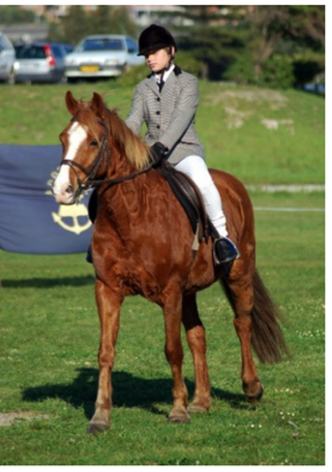
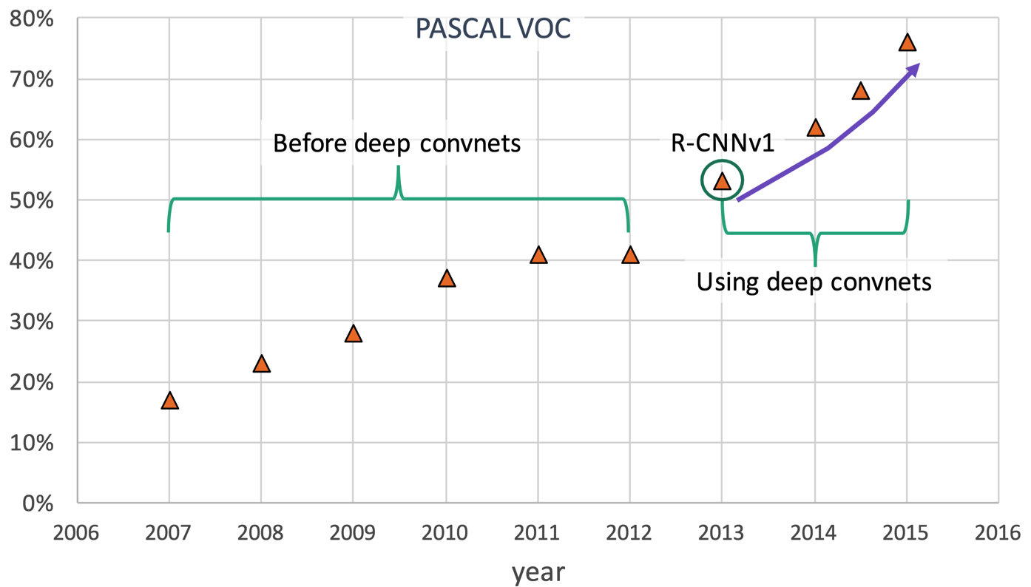
Object Detection
Detection
What objects are there?
Where are the objects?
Challenges
Localization
Multiple instances
Small objects
Car Person Horse
Detection accuracy

Slide 12
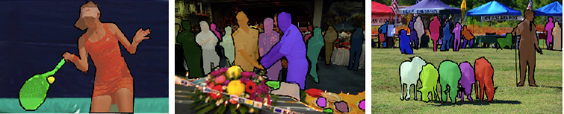
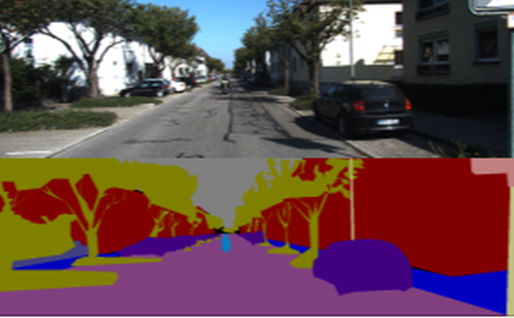
Semantic Segmentation
MS Coco challenge: http://cocodataset.org/#detection-2017
Label each pixel
Computationally intensive
Manual tagging is very intensive
Free path calculation

Slide 13
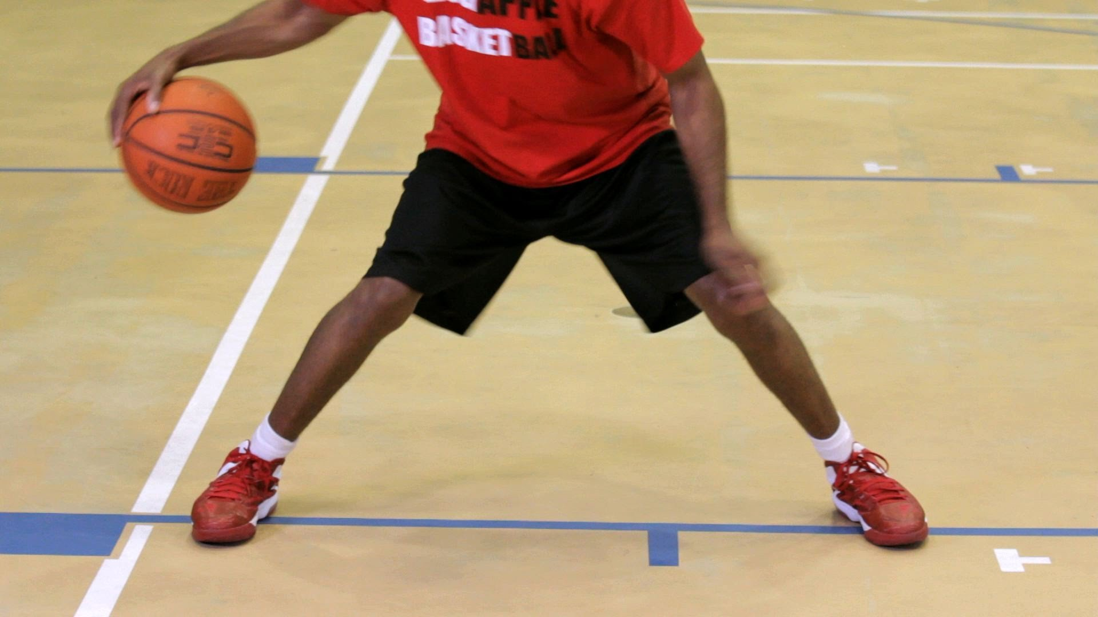
Video to Language
Video classification: YouTube-8M dataset
Video captioning: MSVD
MSR-VTT

Slide 14
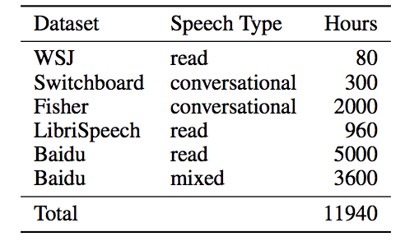
Automatic Speech Recognition
At or near human accuracy when noise levels are contained, single speaker
Metric: word error rate (WER)
Example: Deep Speech 2: WER ~4%
MSR-VTT
https://www.ibm.com/blogs/watson/2017/03/reaching-new-records-in-speech-recognition/
https://www.microsoft.com/en-us/research/blog/microsoft-researchers-achieve-new-conversational-speech-recognition-milestone/
https://arxiv.org/pdf/1512.02595.pdf

Slide 15
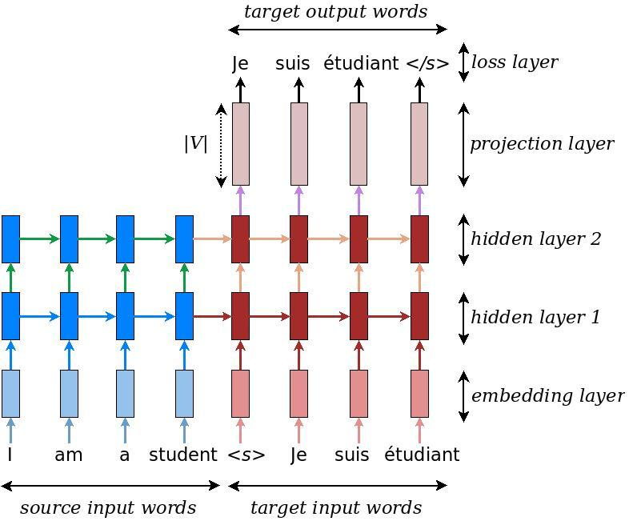
Language to Language Translation
Close to or at human accuracy on some data sets (e.g., https://www.microsoft.com/en-us/research/uploads/prod/2018/03/final-achieving-human.pdf)
Some difficulty in determining the quality of translation
BLEU score is a relatively simple metric, based on the occurrence of machine translated N-grams in the human translations
Other metrics are currently being developed; see the proceedings of the 2017 conference on machine translation: http://www.statmt.org/wmt17/pdf/WMT17.pdf
State-of-the-art engines are neural machine translators

Slide 16
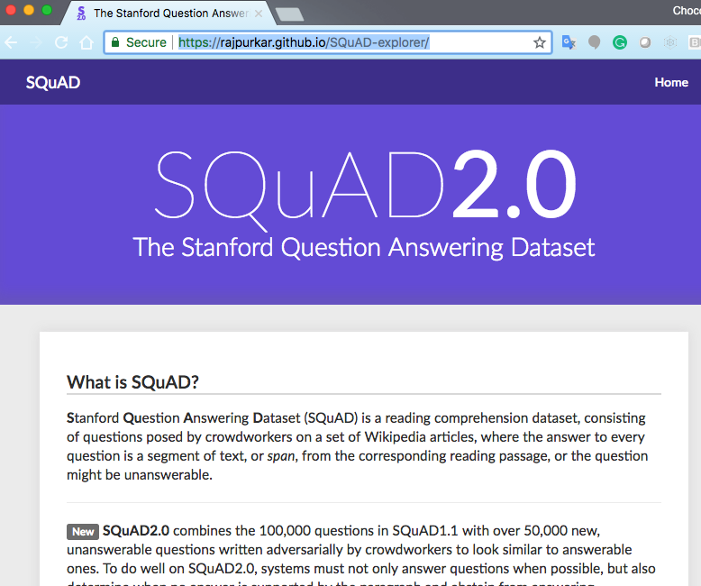
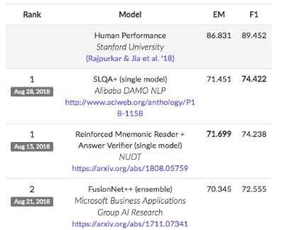
Question–Answer
You are given a text that you read.
You are asked a question.
You need to highlight the answer in the text.
SQuAD/SQuaD2.0 are the datasets and benchmarks developed at Stanford.
State-of-the-art engines are neural machine translators.

Slide 17
Question–Answer
Stanford Question Answering Dataset (SQuAD) is a reading comprehension dataset, consisting of questions posed by crowdworkers on a set of Wikipedia articles, where the answer to every question is a segment of text, or span, from the corresponding reading passage, or the question might be unanswerable.
SQuAD2.0 combines the 100,000 questions in SQuAD1.1 with over 50,000 new, unanswerable questions written adversarially by crowdworkers to look similar to answerable ones. To do well on SQuAD2.0, systems must not only answer questions when possible, but also determine when no answer is supported by the paragraph and abstain from answering.

Slide 18
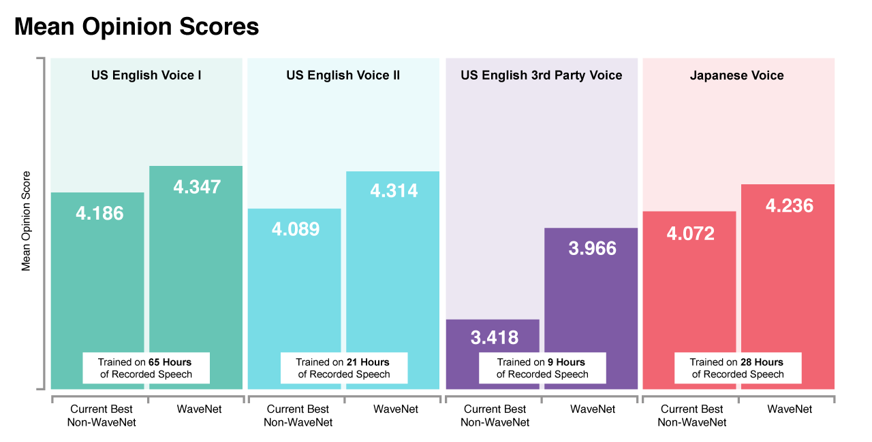
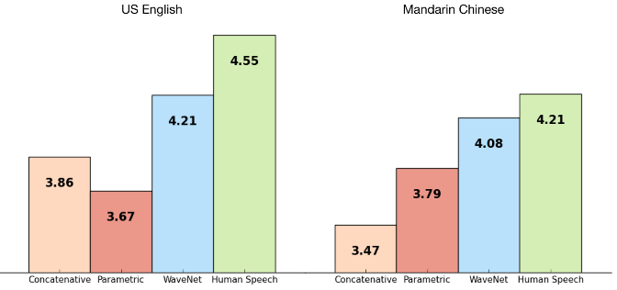
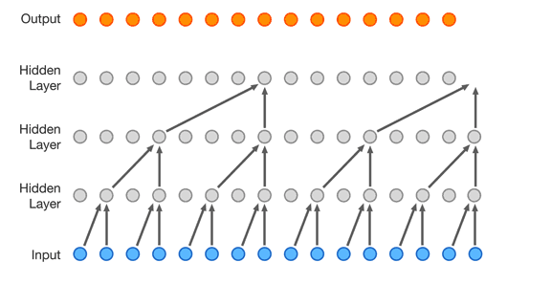

Speech Generation
DL systems are close or at parity
Mean opinion score (MOS) (1–5) is used to evaluate the quality of audio
Arithmetic mean of the marks given by human subjects
WaveNet
WaveNet 2
1,000$×$ faster

Slide 19
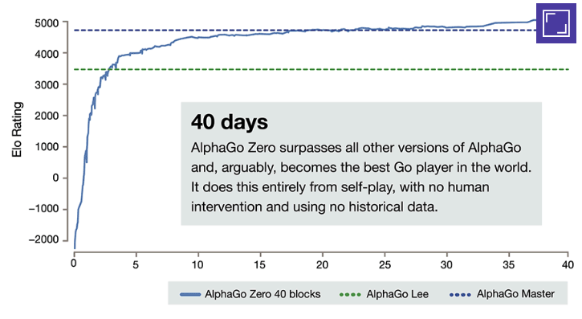
Robotics and Gaming
Deep reinforcement learning (DRL) is used to accelerate learning when an agent is able to interact with the environment.
In December 2017, AlphaGo Zero was able to beat champions in Chess, Go, and Shogi by playing just against itself.
AlphaGo Zero training

Slide 20
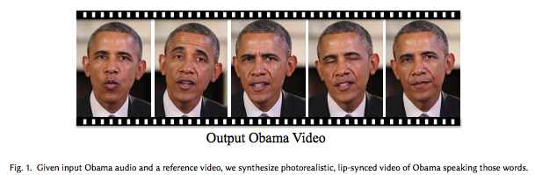
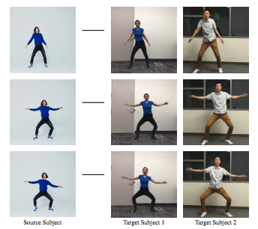
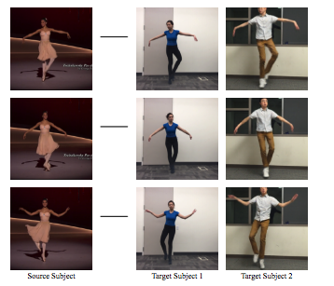
Deep Fakes
It is possible to generate a video of a person speaking a text, provided that there’s enough training data.
http://grail.cs.washington.edu/projects/AudioToObama/siggraph17_obama.pdf
It is possible to transfer an internal keypoint-based pose representation from a source subject to a target subject.
https://arxiv.org/pdf/1808.07371.pdf

Slide 21
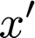
An Artificial Neuron
ReLU
w₁
Nonlinear activation
w₂
w₃
Output
b
Inputs
Scalar bias
Scalar weights
An artificial neuron
x’ = F_{activation} (w₁*x₁ + w₂*x₂ + w₃*x₃ + b)

Slide 22
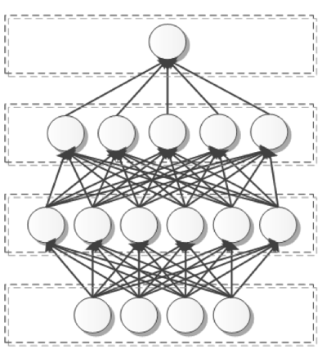
A Fully Connected Layer
It’s very simple to understand but also very resource-intensive.
ReLU
Output
Upper
layers
“Fully connected” layers
x₂
w₁
Nonlinear activation
Neurons
“Depth”
w₂
w₃
Output
Number of, types of layers, activation functions, and so on are collectively known as “model hyperparameters”
b
Inputs
Scalar bias
Lower
layers
Scalar weights
Inputs
An artificial neuron
A layered neural network
x’ = F_{activation} (w₁*x₁ + w₂*x₂ + w₃*x₃ + b)

Slide 23
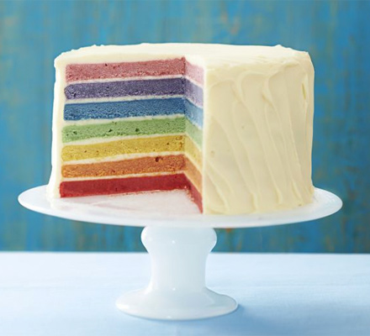
Stacking Layers
Information is passed through the layers.
The layers learn together.

Slide 24
A Loss Function
Outputs
Ground truth
Layer 1
Loss = difference between outputs and ground truth
Layer 1
Layer 1
Inputs

Slide 25
Back Propagation
Training is a process of minimizing loss by varying network parameters.
Outputs
Loss
Gradients
If our loss function and all activations are analytical functions, we can simply compute partial derivatives and follow them:
x1 = x0 + lr * gradient (loss, x)
lr is called “learning rate”
Layer 1
Layer 1
Layer 1
Parameters (weights, biases)
Inputs

Slide 26
Convolution Operation
Three possible filter positions
1 | 2 | 3 | 4 | 5
6 | 7 | 8 | 9 | 10
0 | 0 | 0 | 0 | 0
1 | 1 | 1 | 1 | 2
2 | 3 | 3 | 3 | 5
1 | 2 | 3
6 | 7 | 8
0 | 0 | 0
163
 | 50
=
*
Three possible filter positions
Filter
Output
Input
1*7 | 2*8 | 3*9
6*0 | 7*0 | 8*0
0*1 | 0*1 | 0*1
1*1 | 2*2 | 3*3
6*6 | 7*7 | 8*8
0*0 | 0*0 | 0*0
Sum
Sum

Slide 27
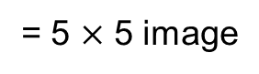
Padding
Avoid information loss at the edges.
Five possible filter positions
0 | 0 | 0 | 0 | 0 | 0 | 0
0 | 1 | 2 | 3 | 4 | 5 | 0
0 | 6 | 7 | 8 | 9 | 10 | 0
0 | 0 | 0 | 0 | 0 | 0 | 0
0 | 1 | 1 | 1 | 1 | 2 | 0
0 | 2 | 3 | 3 | 3 | 5 | 0
0 | 0 | 0 | 0 | 0 | 0 | 0
1 | 2 | 3
6 | 7 | 8
0 | 0 | 0
*
= 5 $×$ 5 image
Five possible filter positions
Filter
Input with padding = 1

Slide 28
Stride: Skip Over
Two possible filter positions
1 | 2 | 3 | 4 | 5
6 | 7 | 8 | 9 | 10
0 | 0 | 0 | 0 | 0
1 | 1 | 1 | 1 | 2
2 | 3 | 3 | 3 | 5
1 | 2 | 3
6 | 7 | 8
0 | 0 | 0
163
 | 29
=
*
Two possible filter positions
Output
Filter
Input
1*0 | 2*0 | 3*0
6*1 | 7*1 | 8*2
0*3 | 0*3 | 0*5
1*1 | 2*2 | 3*3
6*6 | 7*7 | 8*8
0*0 | 0*0 | 0*0
Sum
Sum

Slide 29
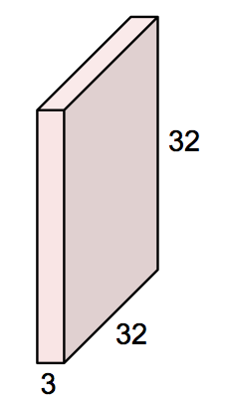

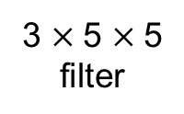
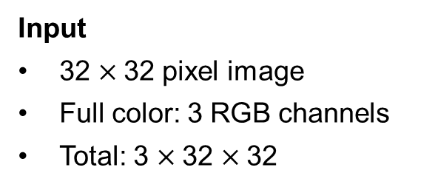
A 2D Convolutional Filter
3 $×$5 $×$5
filter
Input
32 $×$32 pixel image
Full color: 3 RGB channels
Total: 3 $×$32 $×$32
Slide the filter across the input image
Convolve the filter with the input in each position

Slide 30
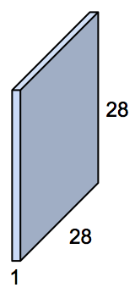
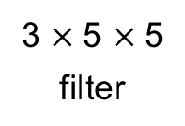
A 2D Feature Map
The operation of convolution gives us one number in each position.
3 $×$5 $×$5
filter
Slide the filter across the input image
28 possible positions horizontally and vertically
Filter parameters:
FC parameters:
3*5² = 75
3*32² = 3,072

Slide 31
1D ConvNets
1D ConvNets are useful in time series data.
Kernel size: 4
Stride: 2
Feature map = 7
f₁
f₂
f₃
f₄
f₅
f₆
f₇
Input = 16
Time
Short range

Slide 32
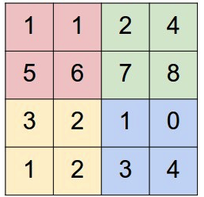
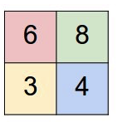
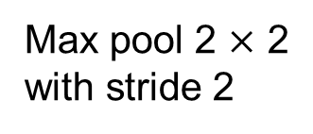
(Max) Pooling
Another trick to simplify/compress inputs
Max pool 2 $×$ 2
with stride 2

Slide 33
(Max) Pooling
Another trick to simplify/compress inputs
Max pool 2 $×$ 2
with stride 2

Slide 34

Regularization
Combat overfitting
Weight decay: add to loss L(θ): λ‖θ‖² to pull weights toward zero
λ (scalar) is a hyperparameter
Also known as “L² regularization”

Slide 35
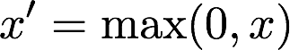
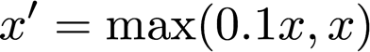
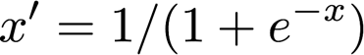
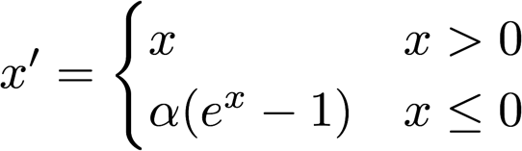
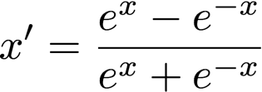
Activation Functions
ReLU
Leaky ReLU
Sigmoid
ELU
Tanh

Slide 36
Speeding Up Convergence
Make sure your gradients don’t vanish.
Make sure your inputs are not too large.
Normalize your inputs!

Slide 37
Normalization
Make it possible to train deeper networks
For each (hidden) layer:
Compute the mean
Compute the variance
Normalize the inputs before activation function
To improve on the normal distribution:
Add scale and offset—learnable parameters

Slide 38

RNNs: One Unit
Unfolded view
Same weights across time steps
Normal view
State s_{t} = ReLU(U*x_{t} + W*s_{t–1})
Output o_{t} = Softmax(V*s_{t}).
Time

Slide 39
RNNs: Layer
Incrementally accumulated state
r₁
r₂
r₃
One output per entire time series, or
One output per one time step
U ₁₁
Time-independent
x_{2 t}
x_{1 t}
Watch out! Explanations are frequently confusing.
Time
x_{1 t–1}
x_{2 t– 1}
x_{1 t–2}
x_{2 t– 2}

Slide 40
RNNs: Stacking Layers
r₁₃
r₂₃
r₃₃
r₁₂
r₂₂
r₃₂
Incrementally accumulated state
Very similar to FC layers
but with state
number of connections is very large!
r₁₁
r₂₁
r₃₁
x_{1 t}
x_{2 t}
Time
x_{1 t–1}
x_{2 t–1}
x_{1 t–2}
x_{2 t–2}

Slide 41
RNNs: n Inputs, m Outputs
El fue a la escuela
r
r
r
r
r
r
r
r
r
He went to school
State has enough information to generate output
Time

Slide 42
RNNs: How Can We Remember Long Term?
Output
r
r
r
r
r
r
r
r
Does this ancient input matter?
Does this recent input likely matter?
Time

Slide 43


LSTMs
State
Forget gate
Remember gate
Output
Output gate
Time
http://colah.github.io/posts/2015-08-Understanding-LSTMs/

Slide 44

GRUs
No output gate
Fewer parameters, faster to train
http://colah.github.io/posts/2015-08-Understanding-LSTMs/

Slide 45
Bi-Directional RNNs
y_{t}
y_{t+1}
y_{t+2}
r
r
r
r
r
r
x_{t}
x_{t+1}
x_{t+2}
Peeking into the future (e.g., language)

Slide 46
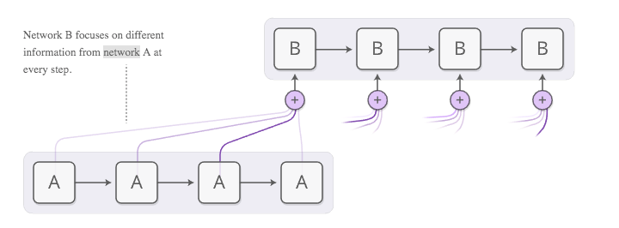
Attention Layers
Paying attention beyond 30–40 words

Slide 47
A Deep Learning Framework
Definitions are rapidly evolving
Convenience library (e.g., Python)
UI tools
Hardware adapters
Accelerated layer library
Debugging tools
Internal network representation
Hardware adapters
Job management

Slide 48
UC Berkeley Caffe
One of the oldest DL frameworks
Well tested and robust
Model defined in protobuf
Run using C/C++ or Python
name: "conv1"
type: CONVOLUTION
bottom: "data"
top: "conv1"
convolution_param {
num_output: 20
kernel_size: 5
stride: 1
weight_filler {
type: "xavier"
}
}

Slide 49
Google TensorFlow
The most popular DL framework ATM
Bindings to most languages
Code base is huge
Containers available, but building it yourself will take you many hours on a modern laptop
Too low-level for most users
Performance is not the best
ATM, distributed training is done via Horovod
Hogs memory

Slide 50
Keras
Perhaps the easiest-to-use DL layer ATM
Bindings to most DL frameworks
Theano, TensorFlow,…
Fastest to quickly prototype
Has some direct bindings to CUDA/CUDNN
Typically, used from a Jupyter notebook

Slide 51
1D ConvNets in Keras
input_unique_values = 345
input_sequence_length = 1024
lstm_units_1 = 64
lstm_units_2 = 32
fc_neurons = 32
model = Sequential()
model.add(Embedding(input_dim=input_unique_values , output_dim=16, input_length=input_sequence_length ))
model.add(Conv1D(cnn_filters, cnn_filter_size, input_shape=(document_max_num_words, num_features),
activation=cnn_activation, kernel_regularizer=regularizers.l2(l2)))
model.add(Flatten())
model.add(Dropout(0.5))
model.add(Dense(fc_neurons , ‘relu’))
model.add(Dense(1, activation = ‘sigmoid’))
model.compile(optimizer = Adam(0.001), loss = ‘binary_crossentropy’, metrics = ‘accuracy’)
model.fit(x, y, epochs = 10, batch = 1024)

Slide 52
NVIDIA DIGITS
Perhaps the easiest-to-use GUI for image processing
Ability to manage datasets
Ability to manage training jobs
Supports multiple underlying DL frameworks
Trained model repository; easy to load your own
Huge number of recipes

Slide 53
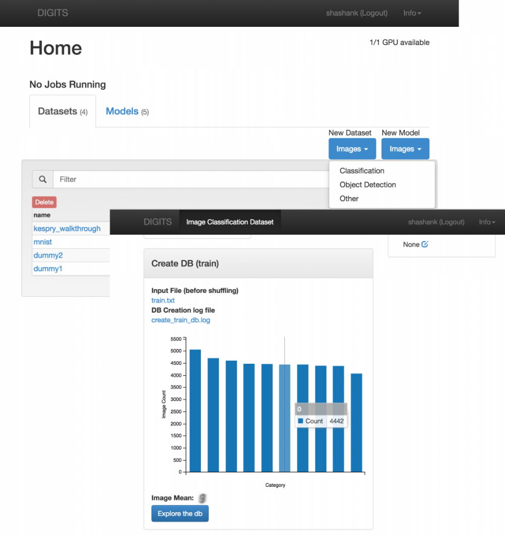
DIGITS: Homepage

Slide 54
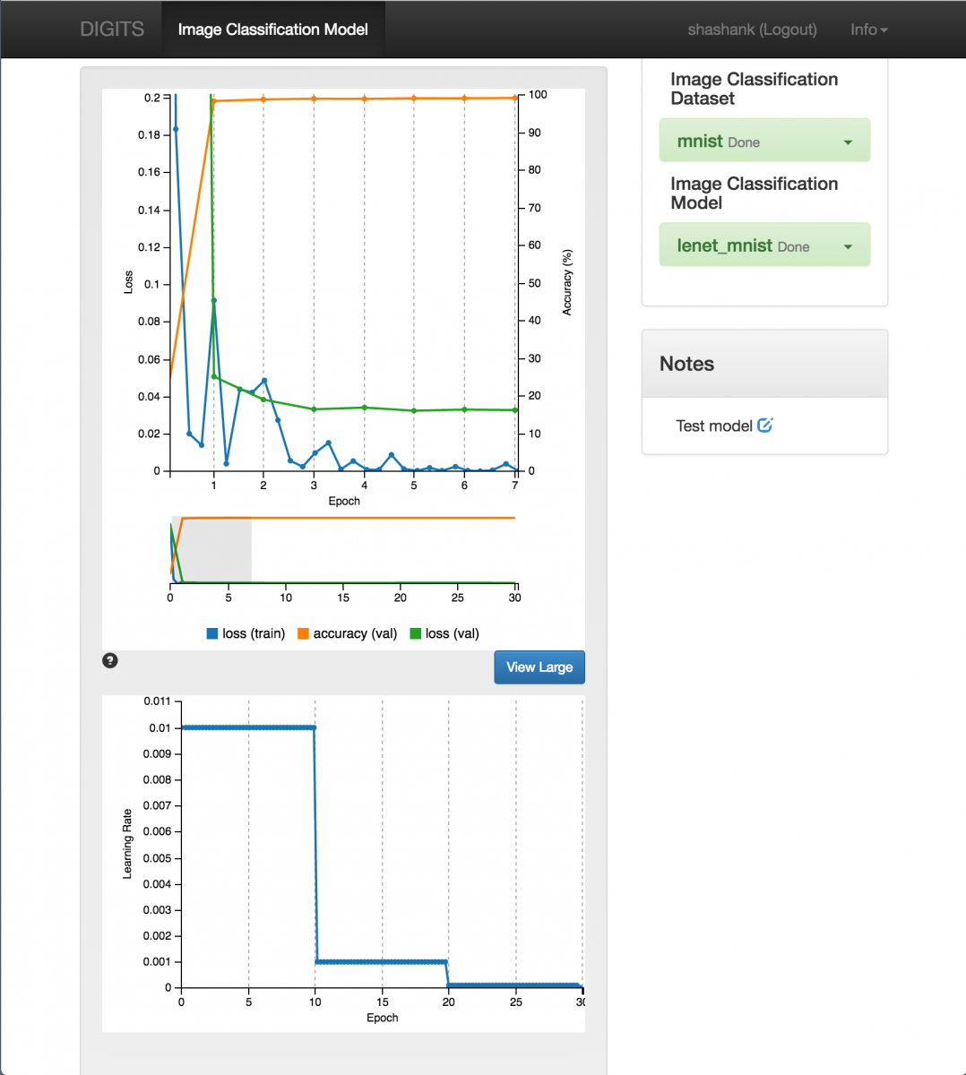
DIGITS: Training

Slide 55
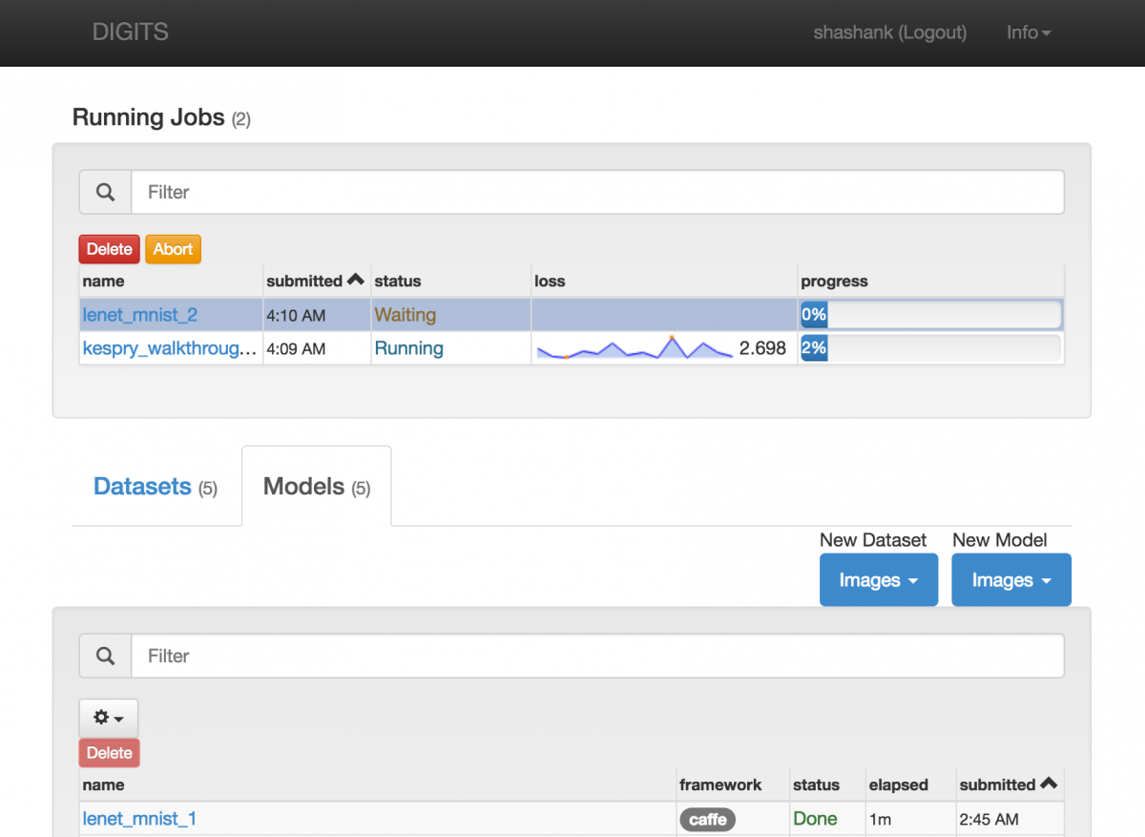
DIGITS: Running Jobs

Slide 56
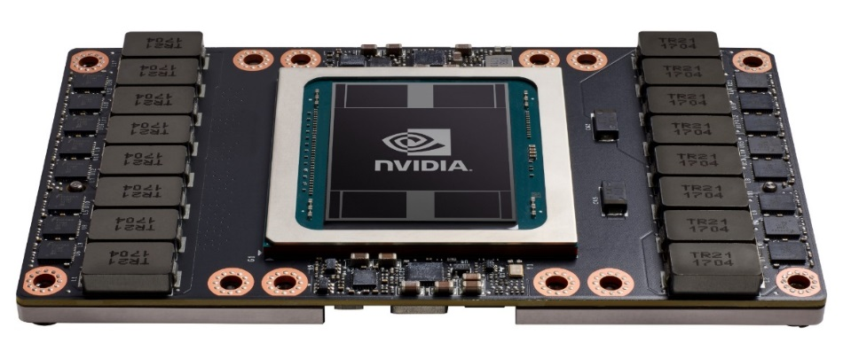
GPUs
Graphics processing unit
Initially, graphics cards
Now, may or may not contain video outputs!
Must use a specialized library (CUDA) to program
Contain many thousands of cores
Power hungry (200–300 W)
PCIe interface, just plug in!
V-100 GPU naked

Slide 57
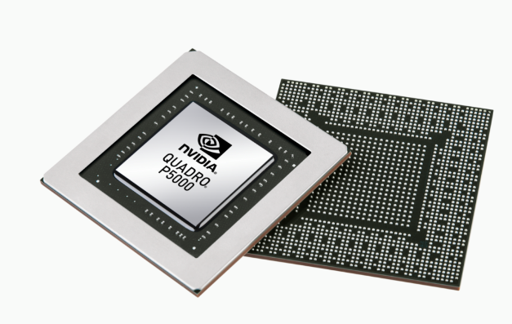
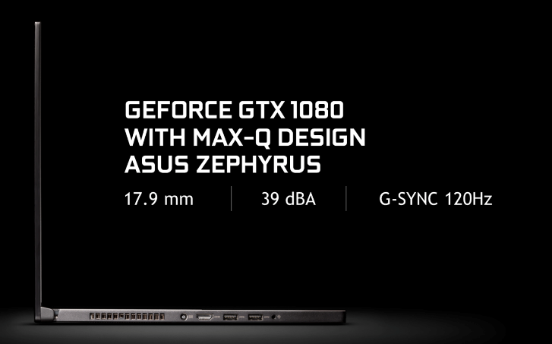
Laptop GPUs
Lightweight and powerful
Quadro P5200 mobile
16G
heavier
GTX 1080 with MAX-Q design
8G
thinner
Best value with consumer grade cards

Slide 58
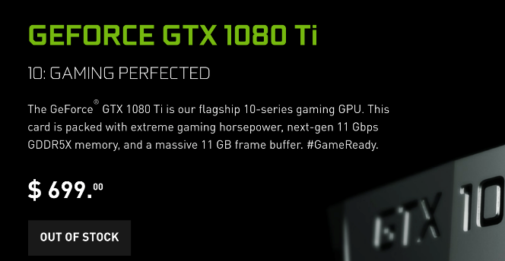
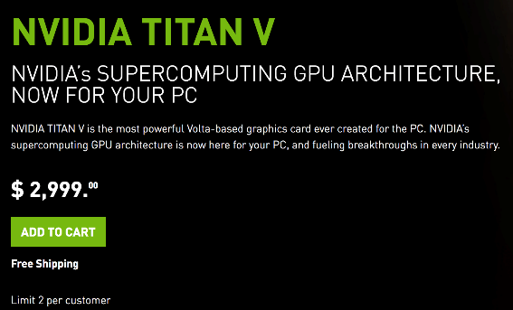
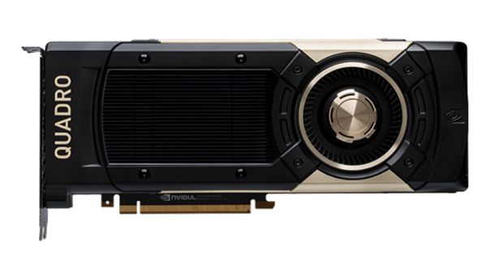
Desktop GPUs
The power on your desk
Pascal architecture
11G
Volta architecture
12G
Quadro GV 1000
Volta architecture
24G
$8,999
Best value with consumer grade cards
Consumer
Enterprise

Slide 59
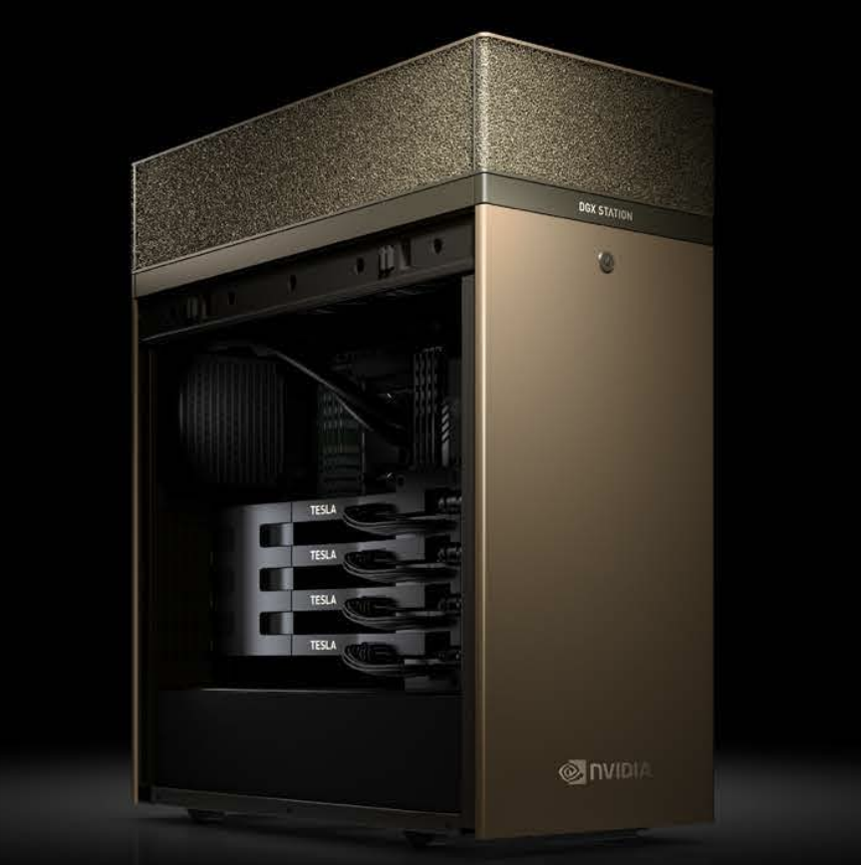
NVIDIA DGX Station
The most powerful DL desktop money can buy
4x V-100 GPUs
128 GB RAM
Intel Xeon E5-2698 v4 2.2 GHz (20-core)
NVLink

Slide 60
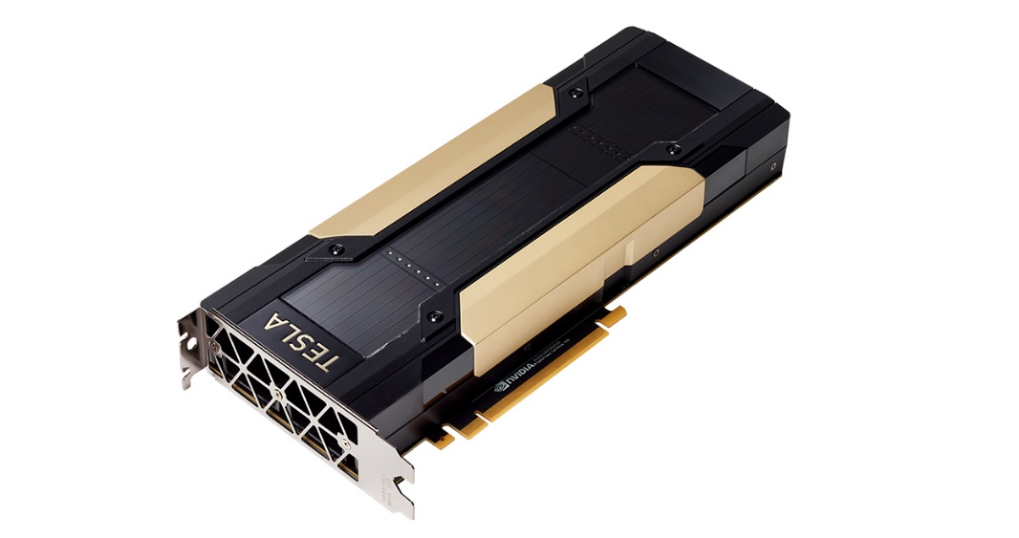
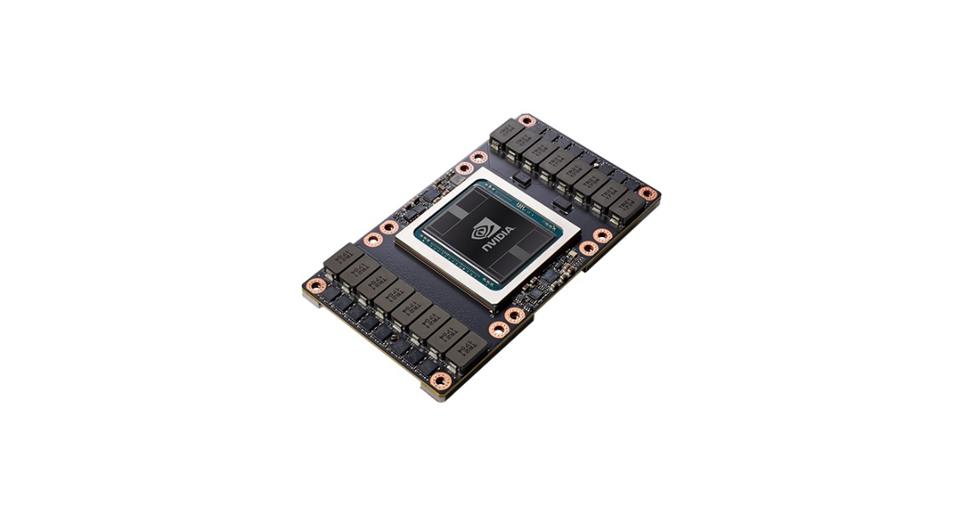
Laptop GPUs
Best available performance, but it comes at a cost
With NVLink 2
300 GB/s interconnect
PCIe
32 GB/s interconnect
Could plug into existing “legacy” servers

Slide 61
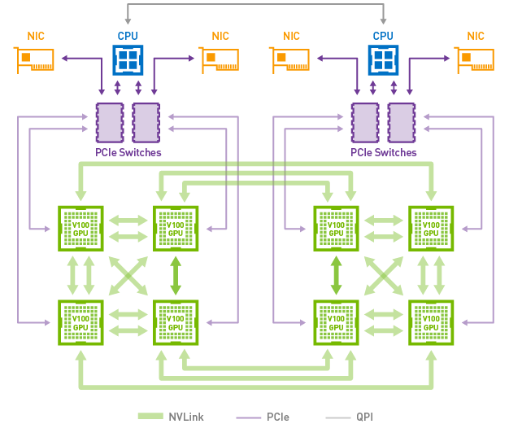
NVLink and DGX-1
GPUs are connected via a hybrid cube mesh

Slide 62

NVSwitch
Designed for DGX-2, which connects 16 GPUs at a cumulative 300 GB/s

Slide 63



Google (Cloud) TPUs
ASICs designed for deep learning
Now v3!
Currently, available in Google Cloud only
Compatible only with TF
Very fast but also very new
Cloud TPU v2 180 teraflops 64 GB high bandwidth memory (HBM)
Cloud TPU v2 Pod Alpha 11.5 petaflops 4 TB HBM 2-D toroidal mesh network
Cloud TPU v3 Alpha 420 teraflops 128 GB HBM

Slide 64




Low Power DL Engines
Explosive growth
GPUs
TPUs
Jetson TX2
Jetson Xavier
256 core Pascal GPU
4 core ARM v8 + 2 Denver cores
8 GB LPDDR4x
16GB eMMC
512 core Volta GPU
8 core ARM v8
16 GB LPDDR4x
32GB eMMC
Coming in fall 2018
20x performance
10x energy efficiency

Slide 65


CPUs for DL
Yes, you can use CPUs, but mainly for inference
It is very tempting to use existing CPU infrastructure (e.g., Big DL)
Download the latest Intel MKL-DNN libraries and Intel-optimized frameworks (e.g., TensorFlow)
Running on a cluster may also work
But, consider just inserting GPUs into existing machines
New CPUs are benchmarked for DL

Slide 66

Adversarial Examples
Neural networks can sometimes be fooled.
It exposes our lack of fundamental understanding about NNs.
If you know the NN, you can confuse it.
Rotation/zoom works, too.
If you can call NN via API, that’s enough.
https://www.labsix.org/physical-objects-that-fool-neural-nets/

Slide 67

Interpretability
DL systems are really, really good.
But they do make mistakes.
Can we build trust?
How do we verify what they learned?
DL systems are deterministic.
But, the data inputs are not.
Some things are rare and confuse people as well.
DL systems can have hundreds of millions of neurons.
How do we debug them?

Slide 68
Model QA
Once the model is deployed, how do we ensure that it continues to work well?
What about dataset drift?
What about concept drift?
What about biases?
Model performance needs to be constantly assessed.
Models need to be constantly retrained.
Additional data needs to be constantly collected.
DL applications need to be designed to be self-improving.

Slide 69

Learning Like a Human
Neural networks today require millions of examples
ImageNet 22K
We don’t learn that way
Techniques such as transfer learning and curriculum learning don’t quite work like this
Perhaps this indicates that the structure of retained information in NNs is very different from the brain
A globular cluster is a spherical collection of stars that orbits a galactic core as a satellite.

Slide 70
Distributed Model training
Many DL models today take days to train, even on the latest GPUs
How do you do R&D?
Design DL network
Train
See the results
Tweak DL network hyperparameters
Repeat until “good enough”
Experiment time is too long; must shorten it
Train on multiple GPUs at the same time!
Train on clusters of machines
Model parallelization: assign different model layers to different GPUs
Data parallelization: split the data batch between GPUs
Convergence? Accuracy?

Slide 71
Better GPU Support
GPUs started as mere graphics cards
In order to use an NVIDIA GPU today you need to download proprietary drivers from NVIDIA
No OS today considers GPUs first-class citizens
You can’t see GPU utilization using OS-level tools
Schedulers (Hadoop, Yarn, Spark) must evolve to support GPUs, but at the moment, this support is lacking or nascent
Metering and chargeback
Quotas, limits, tenant isolation
Low-latency overlay networking
GPU gang scheduling
Inference: GPU hogging

